Slide 1

CS231n 스터디
2022.05.17
발표자 : 서준혁

Slide 2
1. 스터디 진행 상황
매주 금요일. 12:30 릿잇에서
6회차 : 2022. 5. 3 – 9, 10강 스터디
7회차 : 2022. 5. 10 – 11, 12강 스터디
Lecture 9 : CNN Architectures
Lecture 10 : Recurrent Neural Networks
Lecture 11 : Detection and Segmentation
Lecture 12 : Visualizing and Understanding

Slide 3
Lecture 10 – Detection and Segmentation
Semantic Segmentation
Classification + Localization
Object Detection
Instance segmentation

Slide 4
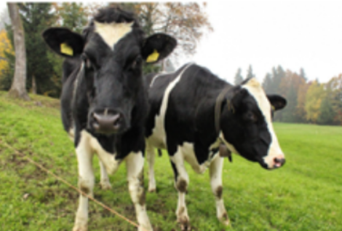
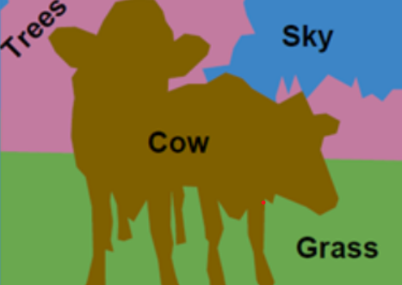
1. Semantic segmentation

Slide 5
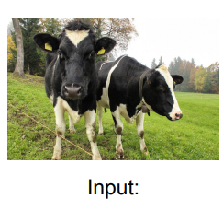
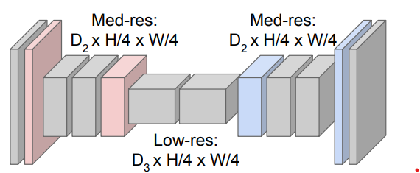
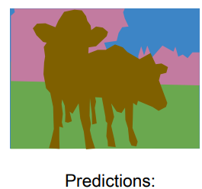
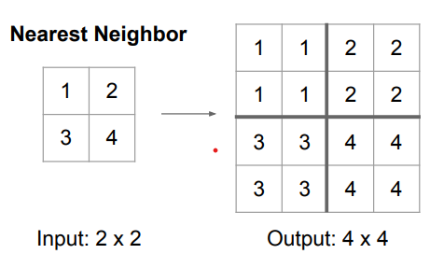
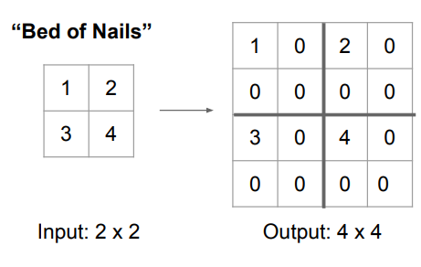
1. Semantic segmentation
Upsampling : Unpooling – Nearest Neighbor, Bed of Nails, Max Unpooling

Slide 6
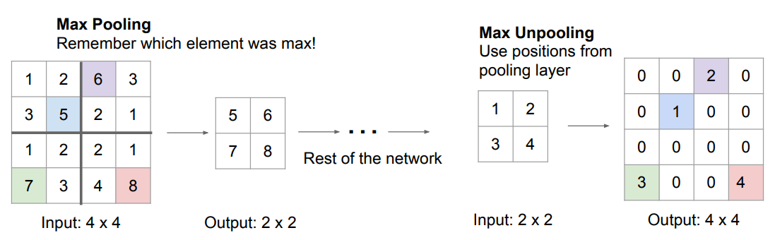
1. Semantic segmentation
Upsampling : Unpooling – Nearest Neighbor, Bed of Nails, Max Unpooling

Slide 7
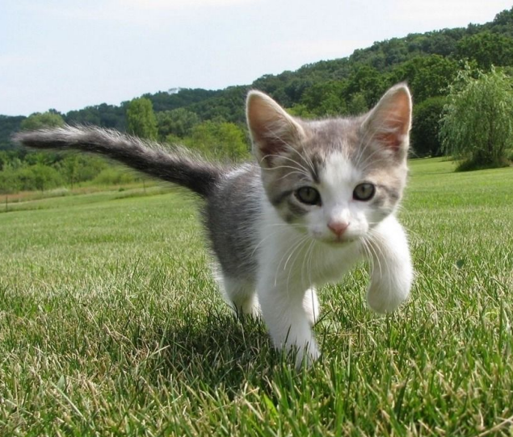
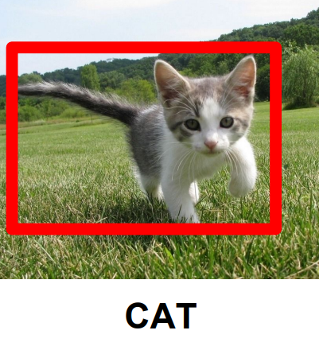
2. Classification + Localization

Slide 8
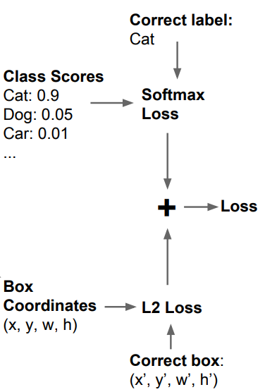
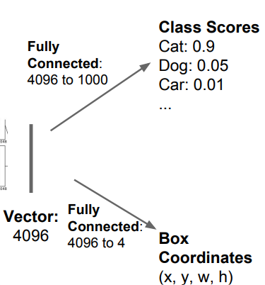
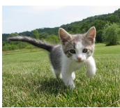
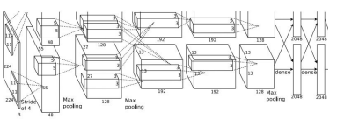
2. Classification + Localization

Slide 9
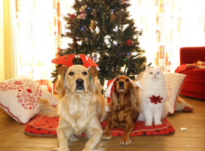
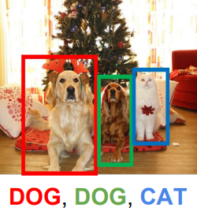
3. Object Detection

Slide 10
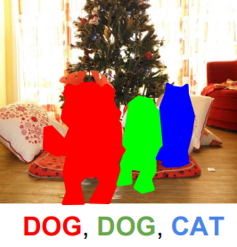
4. Instance segmentation

